Slide 1
MVC Architecture Introduction
By: Thomas Noelcke

Slide 2
Expected prior Knowlage
Basic Programing.
Basic Web Development.
Simple Object Oriented Programing.

Slide 3
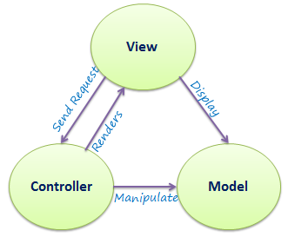
MVC – Model, View Controller
MVC is a popular design pattern that seeks to compartmentalize an application into three parts.

Slide 4
Model
The model handles all of the Data and business logic.
Data manipulation and Business logic should happen here.

Slide 5
View
This is what the user sees and interacts with.
The view should not directly manipulate the model.
The view displays the model and sends requests to the controller.

Slide 6
Controller
Connects the dots between model and view.
Handles requests from view.
Manipulates the model
DOES NOT DO BUSSINESS LOGIC.

Slide 7
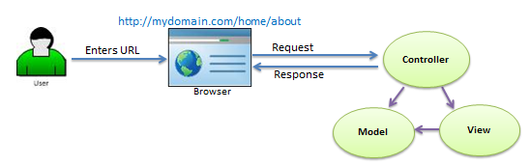
ASP.NET MVC
ASP.NET uses a thin client so the interaction with the various components is as shown below.
The view is rendered on the back end and any interaction with the model goes through the Controller.s

Slide 8
Sources
http://www.tutorialsteacher.com/mvc/mvc-architecture
https://msdn.microsoft.com/en-us/library/dd381412(v=vs.108).aspx

